Slide 1
ANOVA!
GES 408/608

Slide 2
What is ANOVA?
Stands for “Analysis of Variance”
Compares means of multiple groups simultaneously in a single analysis
Assesses whether individuals chosen from different groups are, on average, more different than individuals chosen from the same group
Class of sampling/experimental designs where:
  Three or more “treatments”
  Independent variable (treatments) is categorical
  Dependent/response variable is continuous
Notes:
Fisher’s method for partitioning SS
testing for variation among groups is equivalent to asking whether the groups’ means differ
Variance ratio to determine how far apart means are by looking at variability of means
Example could be growth rate of three different plant species, or three different fertilizer treatments on the same plant species, etc,etc
Or it could be something even more ridiculous lol like…..

Slide 3
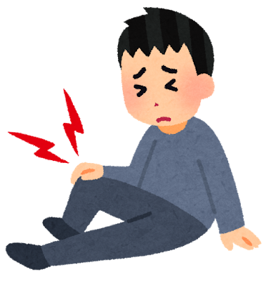
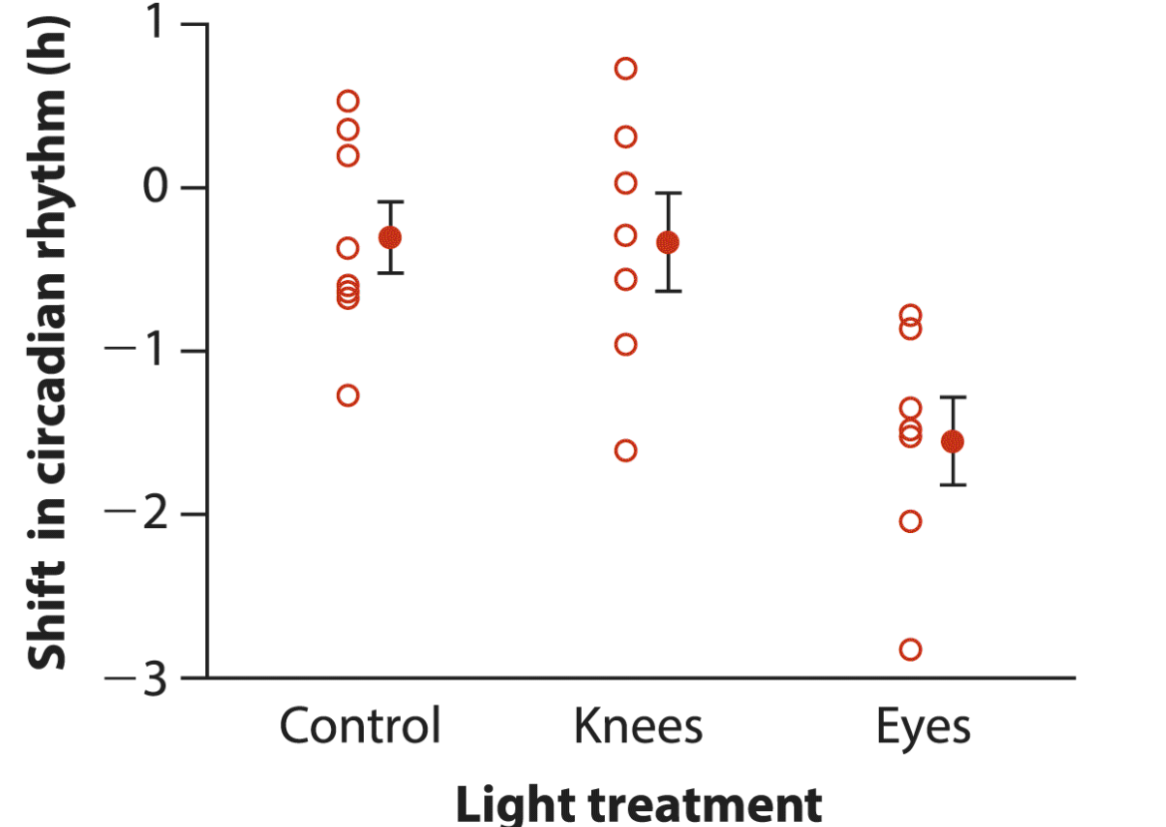
Example: Knees?
Campbell & Murphy 1998: the human circadian clock can also be reset by exposing the back of the knee to light
Wright & Czeisler 2002: are you sure?
Does light treatment affect phase shift?
Notes:
22 people randomly assigned to one of three light treatments. Participants were awakened from sleep and subjected to a single three-hour episode of bright lights applied to the eyes only, to the knees only, or to neither (the control group).
Effects of treatment on the circadian rhythm were measured two days later by the magnitude of phase shift in each participant’s daily cycle of melatonin production
A negative measurement indicates a delay in melatonin production, which is the predicted effect of light treatment; a positive number indicates an advance.
ASK: In this case what would the independent and dependent variables be?
They have a categorical light treatment and they want to see if picking an individual from each of the three groups more different than picking three individuals from the same group

Slide 4
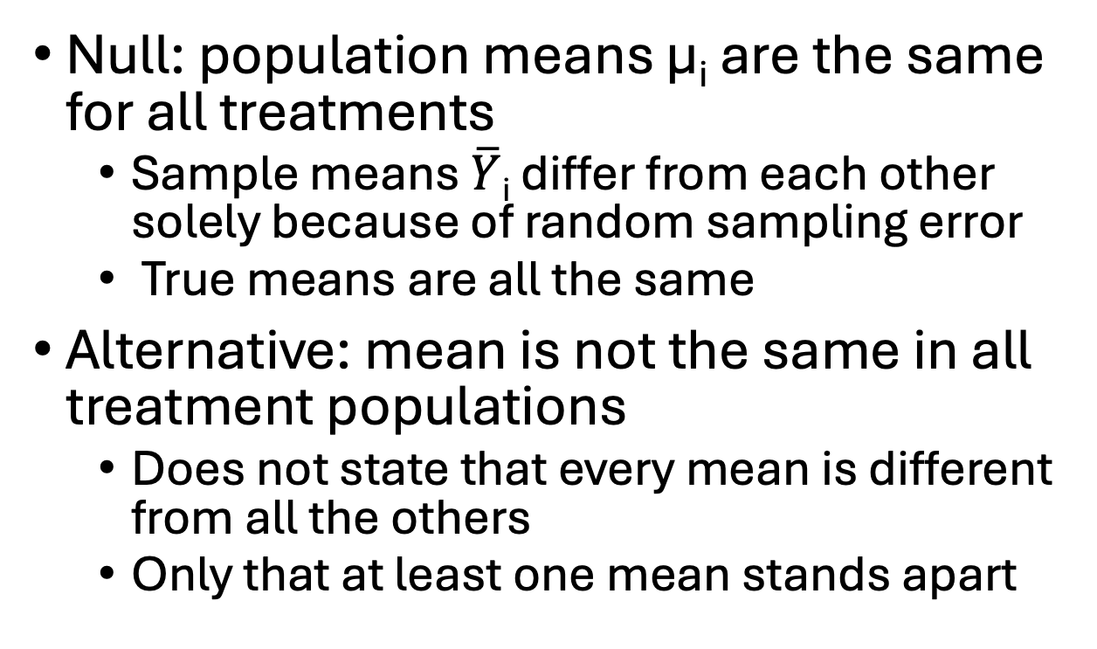
Hypotheses in ANOVA
Null: population means μ_{i} are the same for all treatments
  Sample means $\overline{Y}$_{i} differ from each other solely because of random sampling error
  True means are all the same
Alternative: mean is not the same in all treatment populations
  Does not state that every mean is different from all the others
  Only that at least one mean stands apart
H₀: μ₁=μ₂=μ₃...= μ_{i}
H_{A}: At least one μ_{i} is different from the others
Notes:
Null – no treatment effect, and all means are equal (with some random error thrown in)
Alternative – at least 1 mean is different
ASK: so what would the knee hypotheses be?

Slide 5
Meaning of Hypotheses
We can estimate how much variation among group means ought to be present from sampling error alone if the null hypothesis is true
  Even with the same true mean, the data would likely show a different sample mean for each group (sampling error)
If the null hypothesis is not true, then there are real differences in means among the groups
  Still differences among sample means caused by chance
  Also differences among sample means caused by real variation among population means
  ANOVA lets us determine whether there is more variance among the sample means than we would expect by chance alone

Slide 6
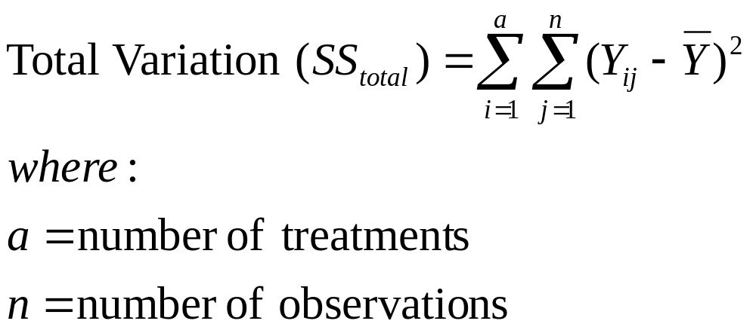
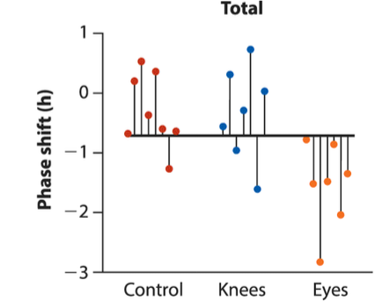
Sum-of-Squares
Separates the two sources of variation in the data: within groups and among groups
Notes:
Total variation regardless of group
Deviation between each observation and the grand mean
This can be split into two parts…

Slide 7
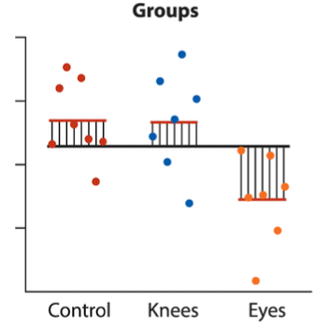
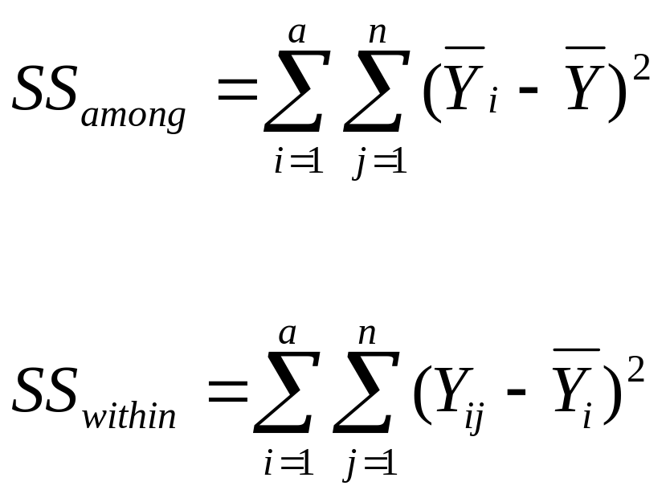
Variation Among vs. Within Groups
Deviation between the mean of the group to which the observation belongs and the grand mean (SS_{groups})
Describes variation among treatment means
Notes:
Y-bar I is the mean of group I, do each one for the no of observations in each group
Can be read as ssamong or ssgroup

Slide 8
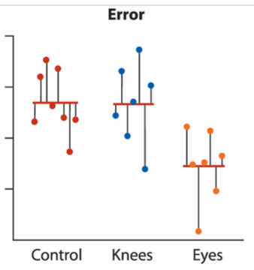
Variation Among vs. Within Groups
Deviation between each observation and its group mean (SS_{error})
Residual SS, residual variation, error variation
Notes:
Y ij are individual observations and again y-bar I is the mean of group I
SS _{total} = SS _{among} + SS _{within}
If the variation in treatment means is BIGGER than the variation in individuals in the entire population, then there must exist some effect of the treatment
So, if SS_{among} = SS_{within}, there is NO treatment effect
So, if SS_{among} >> SS_{within}, there IS A treatment effect

Slide 9
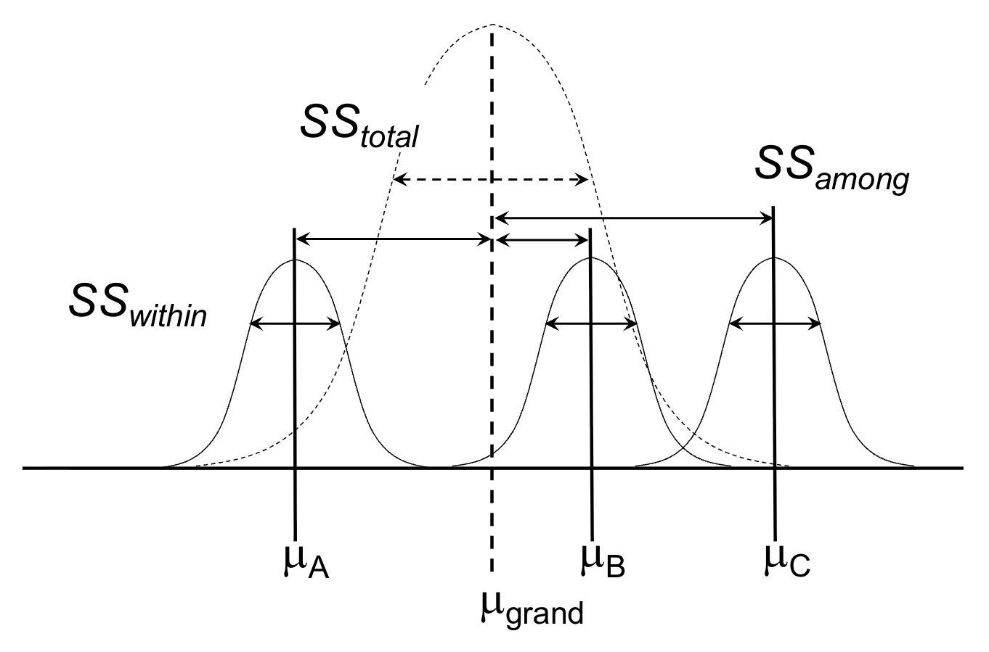
Notes:
Dotted line = total variability with the mean across all the groups with all the data
Data is split into groups and then you have the group means abc
Ss within is the variance within each group, ss error
Ss among is how far is each group mean from the grand mean, ss groups

Slide 10
Mean Squares
Group mean square (MS_{groups} or MS_{among})
SS_{groups or among} divided by DF_{groups}
  DF_{groups} is one less than the number of groups
Measures the observed amount of variation among the sample means from different groups

Slide 11
Mean Squares
Error mean square (MS_{error} or MS_{within})
SS _{error or within} divided by DF_{error}
  DF_{error} is total number of data points minus the number of groups
Measures variance within groups (variation among individuals within the same groups)

Slide 12
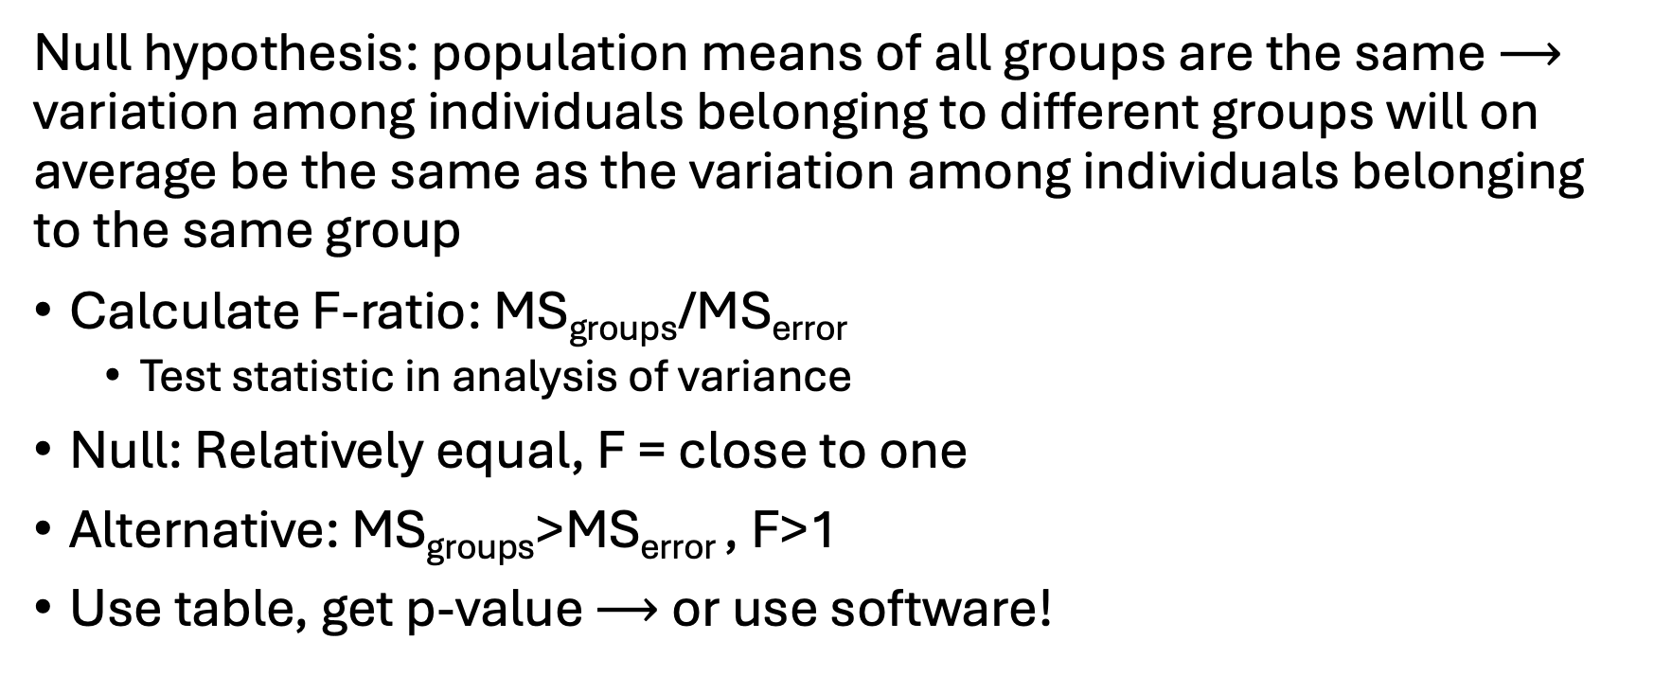
F-ratio
Null hypothesis: population means of all groups are the same $⟶$ variation among individuals belonging to different groups will on average be the same as the variation among individuals belonging to the same group
Calculate F-ratio: MS_{groups}/MS_{error}
  Test statistic in analysis of variance
Null: Relatively equal, F = close to one
Alternative: MS_{groups}>MS_{error} , F>1
Use table, get p-value $⟶$ or use software!
Notes:
Ms among / ms within
Drawing on sticky note – put on board

Slide 13
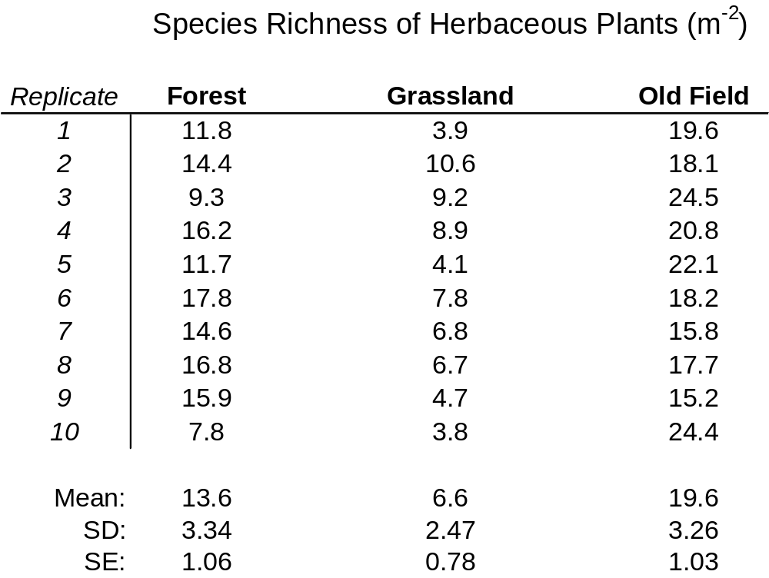


Notes:
Example Data

Slide 14
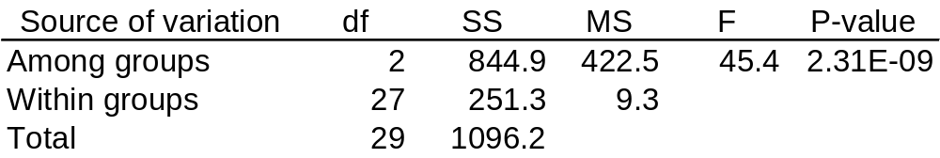
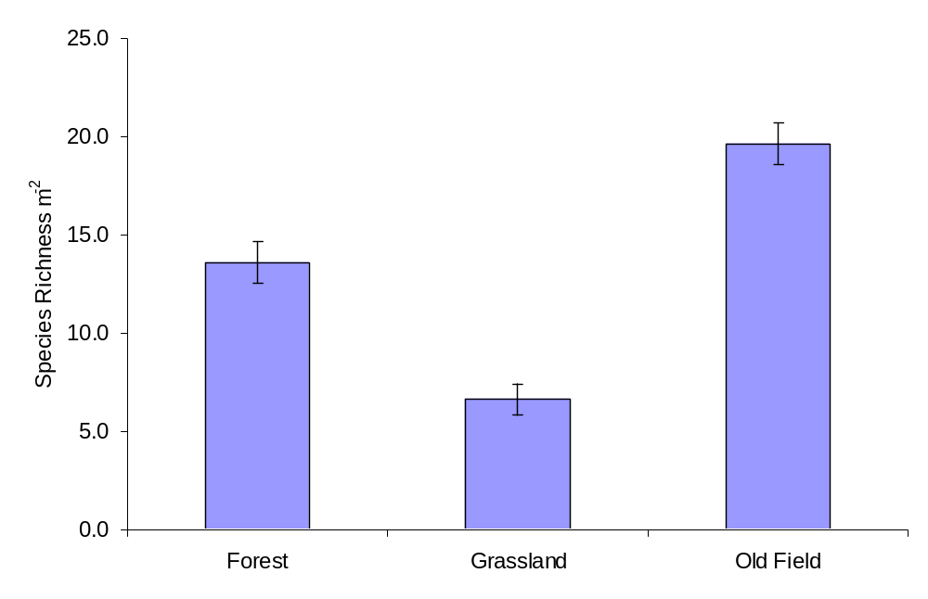

Notes:
Remember ms among = ms groups, ms within = ms error
ASK: 30 seconds talk to your classmates: can we accept or reject the null hypothesis, and then what does that mean in terms of the means of the groups?
Reject null – key point is that at least one mean is different, doesn’t mean they are alllllll different from each other

Slide 15
Assumptions of ANOVA
Need to be true for all groups
  Samples independent & identically distributed (random sampling)
  Variances are homogeneous among groups
  Residuals are normally distributed
  Samples treated identically
  Main effects are additive (one does not influence the other)
The Kruskal–Wallis test, a nonparametric method based on ranks, is the equivalent of the Mann–Whitney U-test
  Has nearly the same power as ANOVA when sample sizes are large
Notes:
transformation can help with the homogenous variance thing
Not the best to use Kruskal-wallis with small sample size

Slide 16

Which groups are different?
You’ve already carried out an ANOVA and the null hypothesis of no differences among means has been rejected. What now?
Unplanned comparison: testing all pairs of means to find out which groups stand apart from the others
Tukey–Kramer test!
But the risk of committing a Type I error increases as you increase the number of comparison made a posteriori
Notes:
ASK: remind me what does an ANOVA tell us if it’s significant!!
One of the means is different!
A posteriori means afterwards

Slide 17
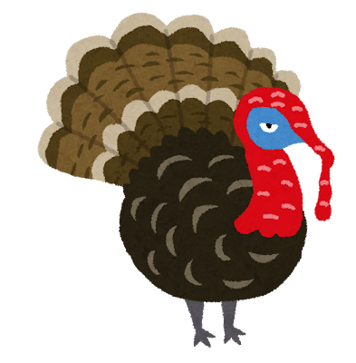
Tukey–Kramer
Works like a series of two-sample t-tests, but it uses a larger critical value to limit the Type I error rate.
With the Tukey–Kramer test, the probability of making at least one Type I error throughout the course of testing all pairs of means is no greater than our significance level α.
  Statistically controls for the fact that many comparisons are being made by downgrading α
α=0.05 for experiment
Notes:
0.05 is just fine for ANOVA

Slide 18
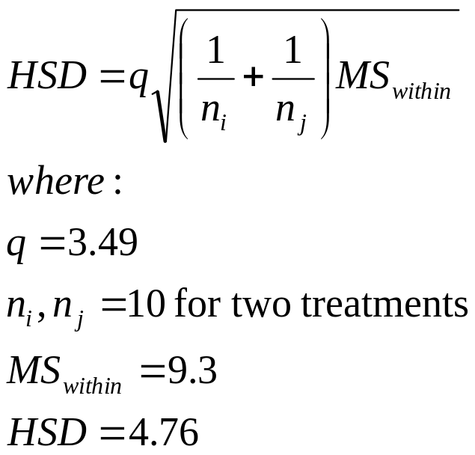
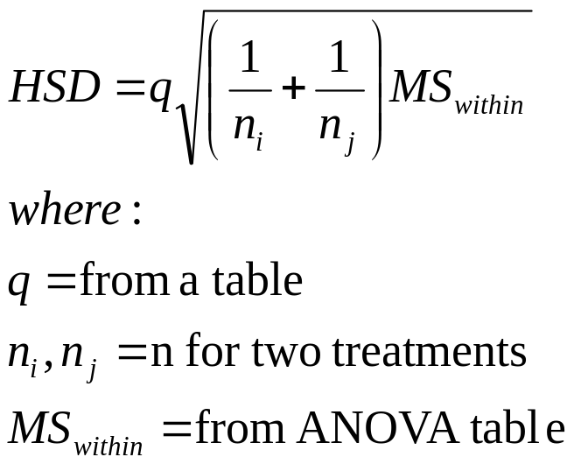
Tukey-Kramer
Example: Any pair of means that differ by more than 4.76 are significantly different at α=0.05
General Formula:
Notes:
Means of two groups have to be at least 4.76 units apart for them to be significantly different!!
Statistical software will give you a table with each comparison laid out with a p value for each, and you can see which pairs are significant and which are not!

Slide 19

Species richness of herbaceous plants: HSD = 4.76
c
|Forest – Grassland| = 6.98
|Forest – Old Field| = 6.01
|Grassland – Old Field| = 12.99
a
b
Notes:
If two bars have the same letter they are not significantly different. Draw picture on board!!

Slide 20
Tukey-Kramer
Results do not imply that pairs that are not significantly different have the same means
  Assuming that they do would be making the mistake of accepting a null hypothesis
The results merely indicate that a test of their differences did not reject H₀
Notes:
Can use grassland herbs example that I drew on the board with the last slide here

Slide 21





Try it yourself!
ANOVA practice activity with leaf litter decomposition – do different canopy types affect the amount of leaf mass lost from experimental units placed in forests?
Due after fall break on 10/14 at 11:59PM!

Slide 22
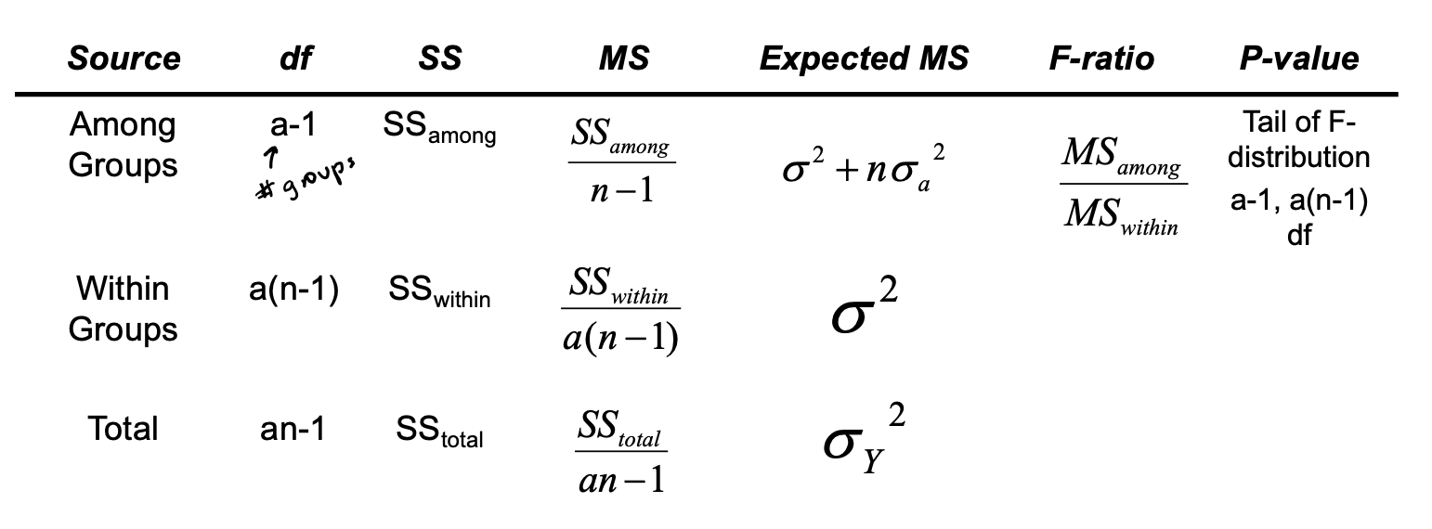
Reference: ANOVA Table

